Slide 1
Great Observing Sites in New Mexico
And where to find them
Alan Scott
TAAS

Slide 2
What makes a good observing site?
It depends on what you want to do with it!
Galaxies, nebula, globular clusters and open clusters benefits from dark skies
Lunar, planet or double star observing is more tolerant of light pollution
Dark Skies!! Lack of light domes, headlights or other lights
Access (a road and permission) to the site
Amenities – such as food, motel, gas, restrooms and/or warming shack
Reasonably close to home
Reasonably warm
Possibly a large, flat area for telescope setup
Safety! This can be physical security (a gate), geographical security (away from high crime areas) or crowd security (safety in numbers)
Notes:
Safety – Vekol road

Slide 3
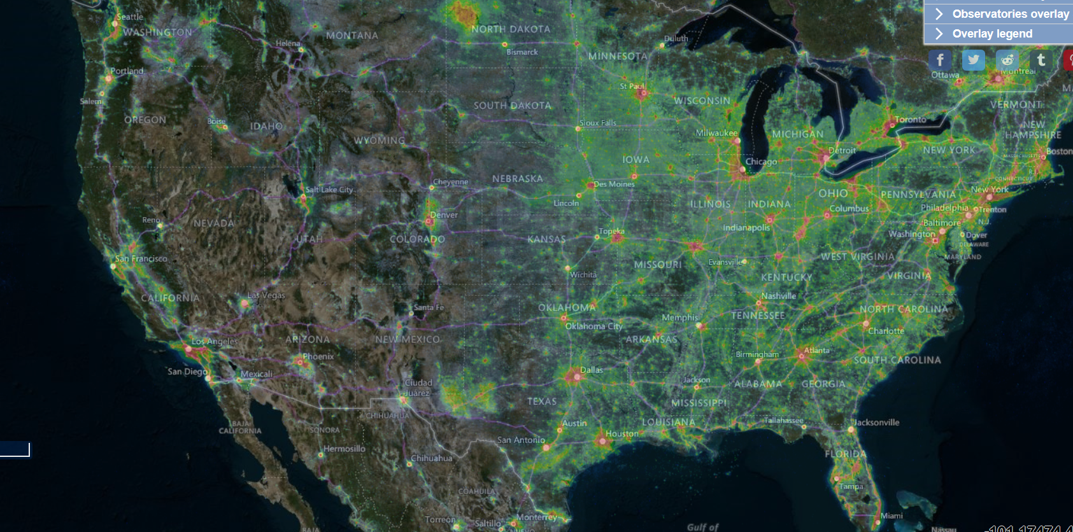
Light pollution of the US
Credit: lightpollutionmap.info

Slide 4
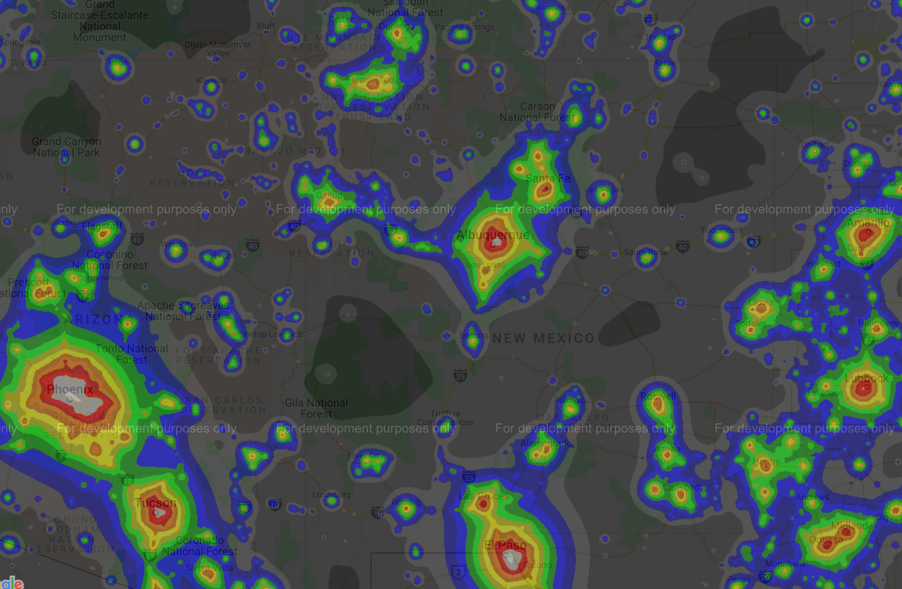
Light pollution of the southwest US
Credit: http://djlorenz.github.io

Slide 5
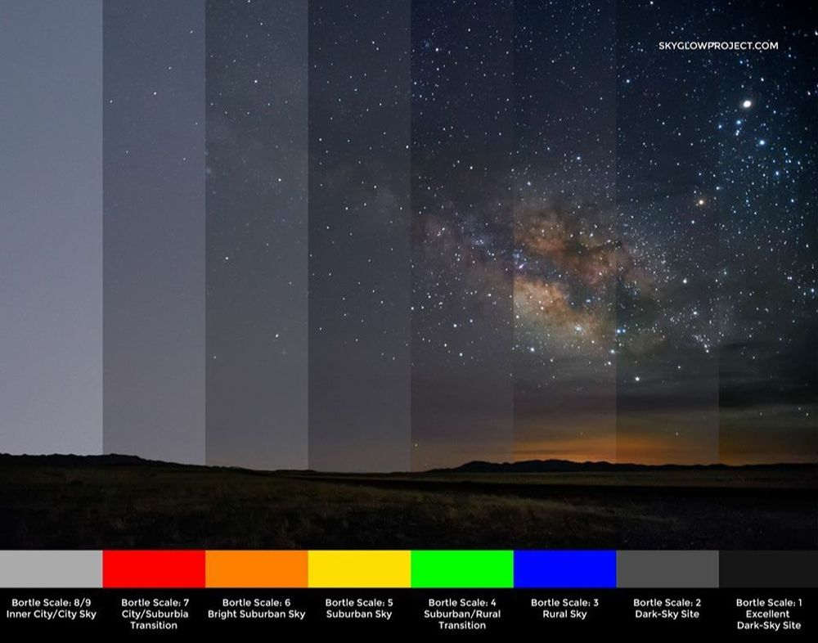
Bortle scale
Credit: SkyGlowProject.com

Slide 6
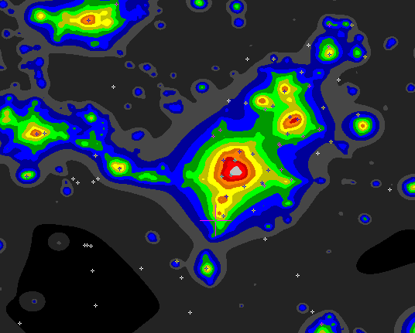
Light pollution maps

Slide 7
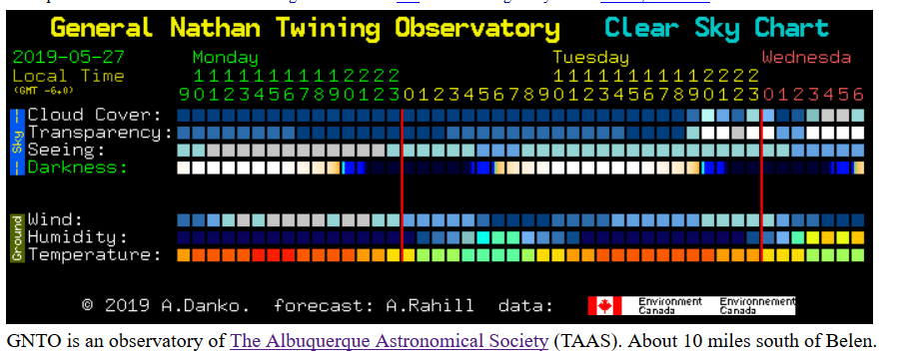
Light pollution maps
http://www.cleardarksky.com/csk/prov/New_Mexico_clocks.html

Slide 8
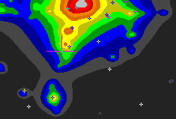
Light pollution at GNTO (hint, we are blue)

Slide 9
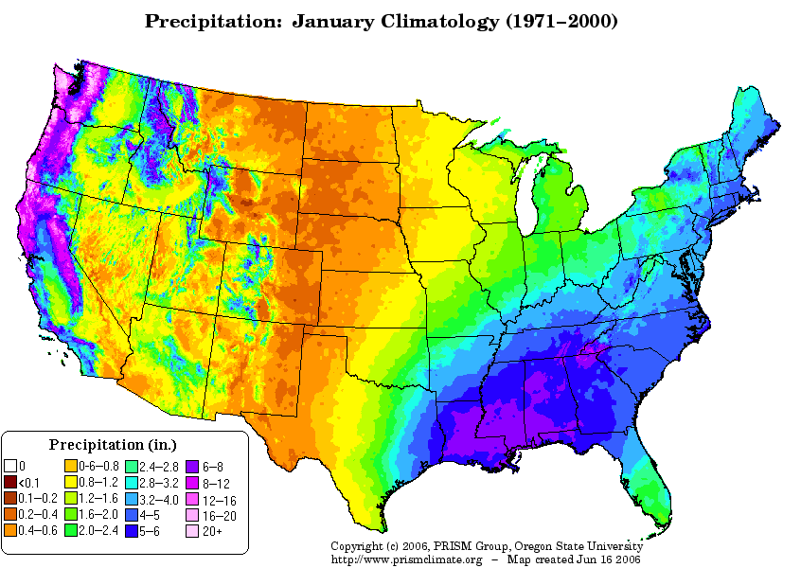
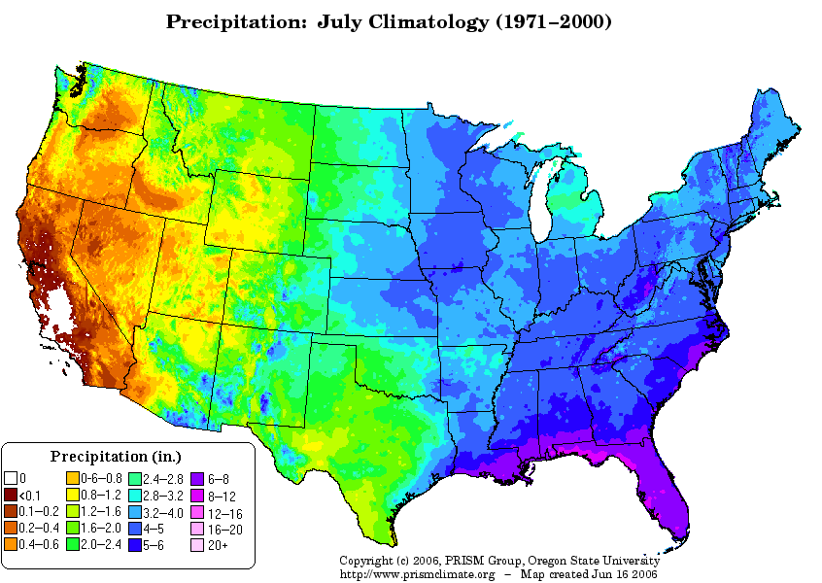
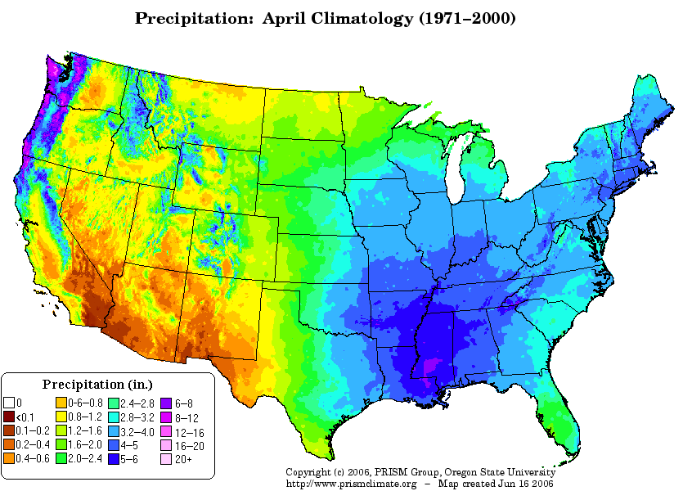
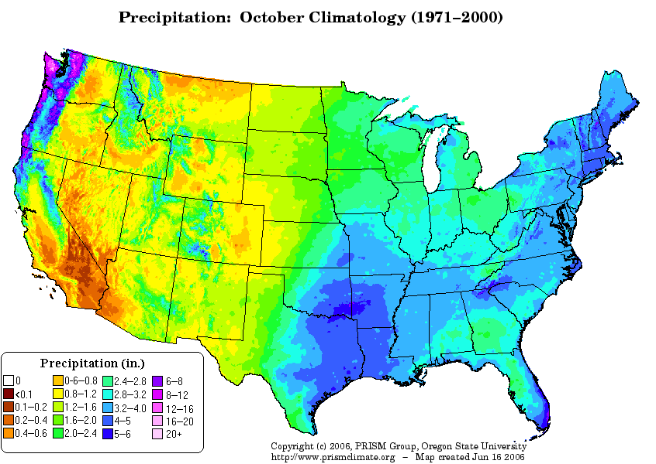
Climate

Slide 10
Private land

Slide 11
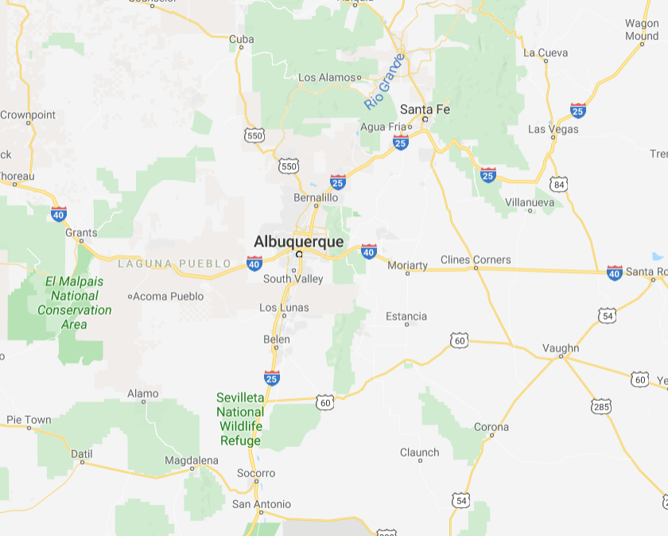
Access (roads)

Slide 12
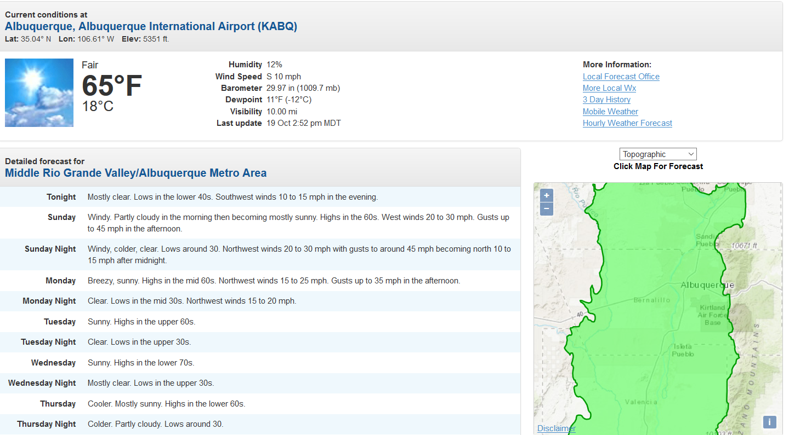
Weather.gov – Albuquerque

Slide 13
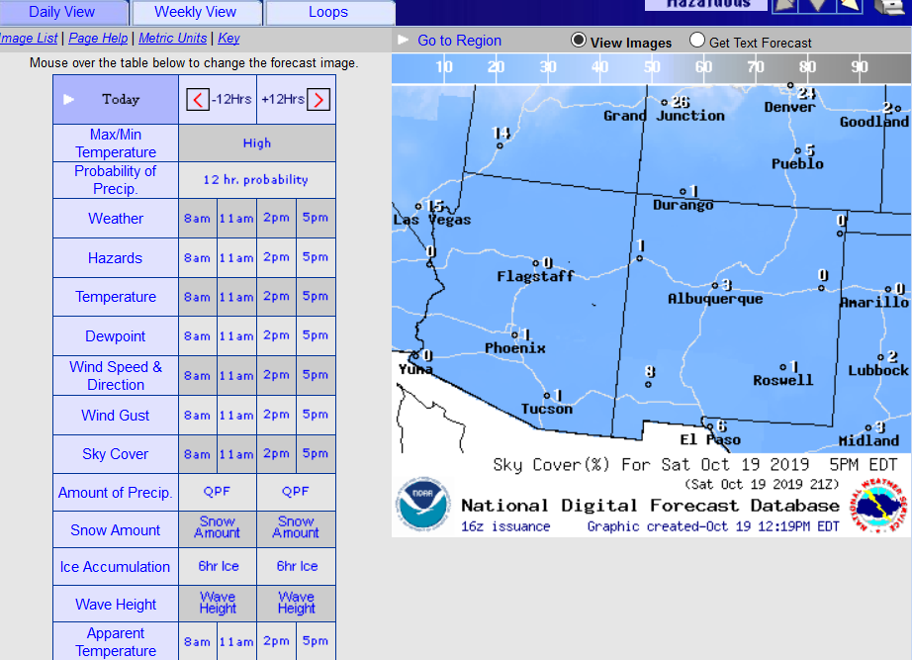
Weather.gov – daily view

Slide 14
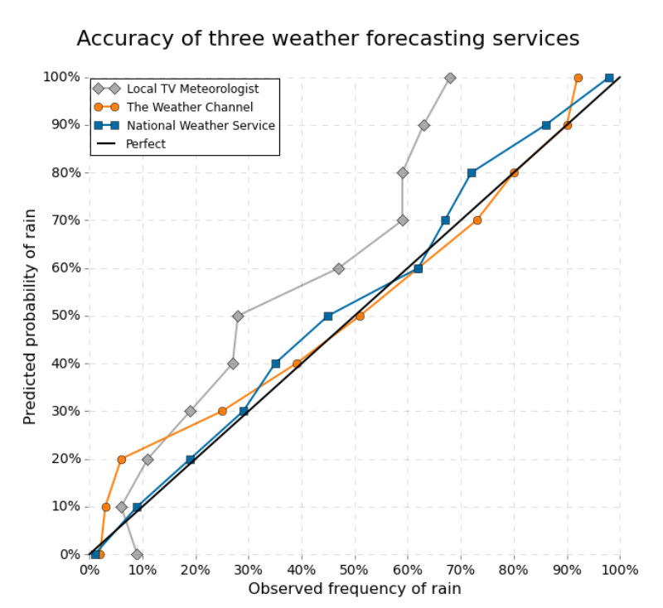
Weather.gov – Accuracy

Slide 15
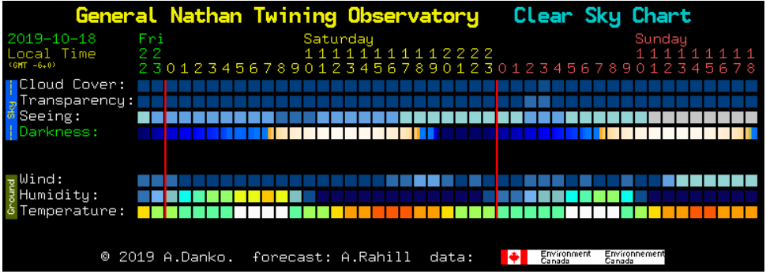
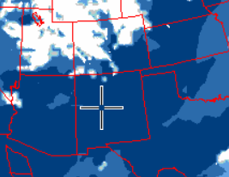
Clear Sky Clock
http://www.cleardarksky.com/csk/prov/New_Mexico_clocks.html

Slide 16
Meteoblue.com - Astronomical
https://www.meteoblue.com/en/weather/forecast/seeing/34.651N-106.792E

Slide 17
Your driveway or back yard
Light pollution score: probably pretty bad. (Mine in NM is orange, CO is dark blue)
Access: walk
What to observe: Urban list, double stars, moon, planets
Safety: Good (I hope)
Why observe here: Hot Chocolate. Warm house. Easy setup.

Slide 18
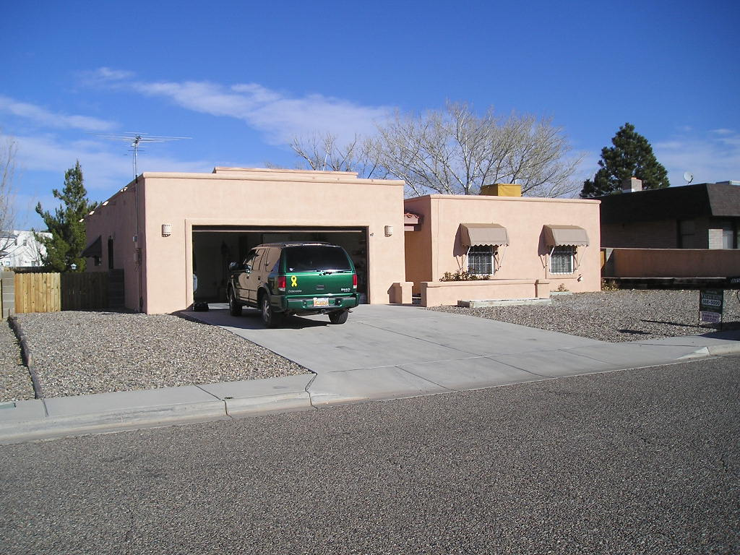
My driveway

Slide 19
GNTO
Light pollution score: Light Blue. Light pollution mostly north
Altitude: about 4500 feet
Access: Dirt road. 2 wheel drive OK unless it rains
Amenities: pit toilet, womens RV toilet, warming building, 16" observatory in a dome, 16" loaner dobsonian
Time from Albuquerque: 1 hour
Directions: South southwest of Belen. Ask for directions.
Why observe here: Relatively good skies about an hour from Albuquerque. Warming shack. Some of the friendliest astronomers on this planet.

Slide 20
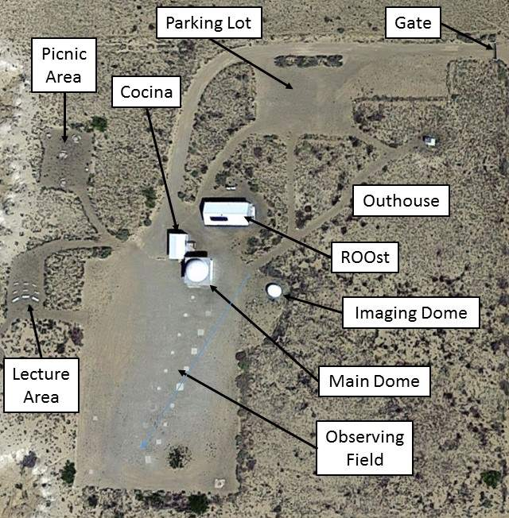
GNTO
Notes:
Mention pad alignment. Mention non keyholder buildings.

Slide 21
Oak Flat
Light pollution score: Dark Yellow. Light pollution mostly west. Skies are darker than the light pollution score indicates.
Altitude: about 7600 feet
Access: Paved road. About 10 miles south of Tijeras.
Amenities: No toilets. As per Dee, there’s always a tree!
Time from Albuquerque: 30 minutes
Directions: I-40 to Tijeras. Drive south on NM 337. Follow signs.
Misc: Oak Flat is not open at night. Just observe on the entrance road.
Why observe here: Relatively good skies to the east. Close to Albuquerque.

Slide 22
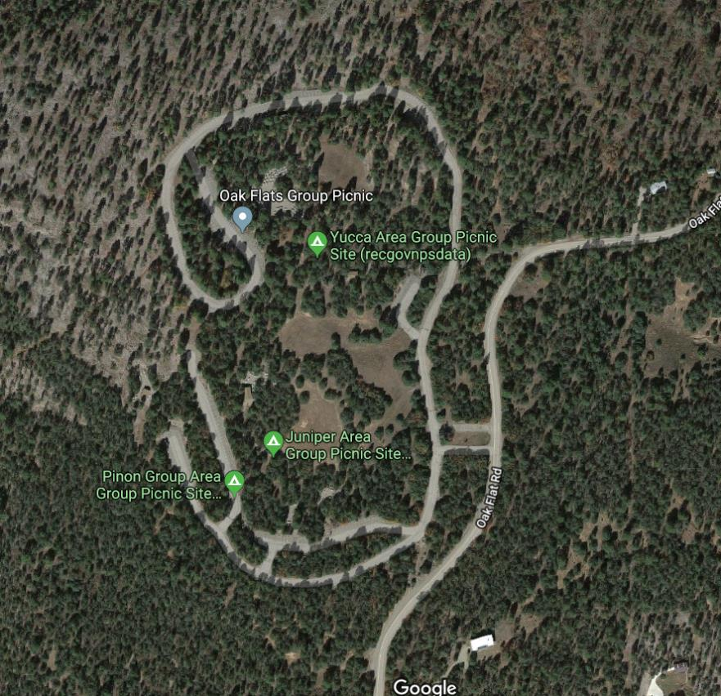
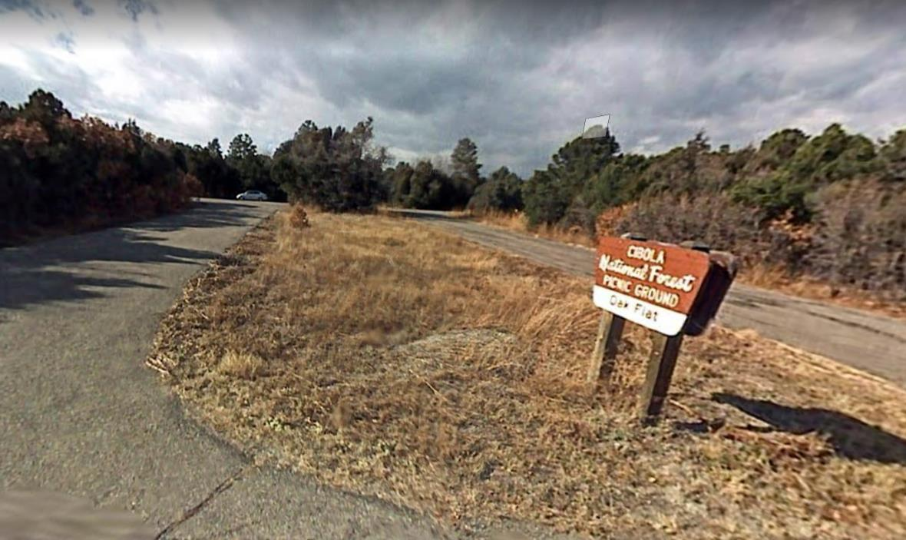
Oak Flat

Slide 23
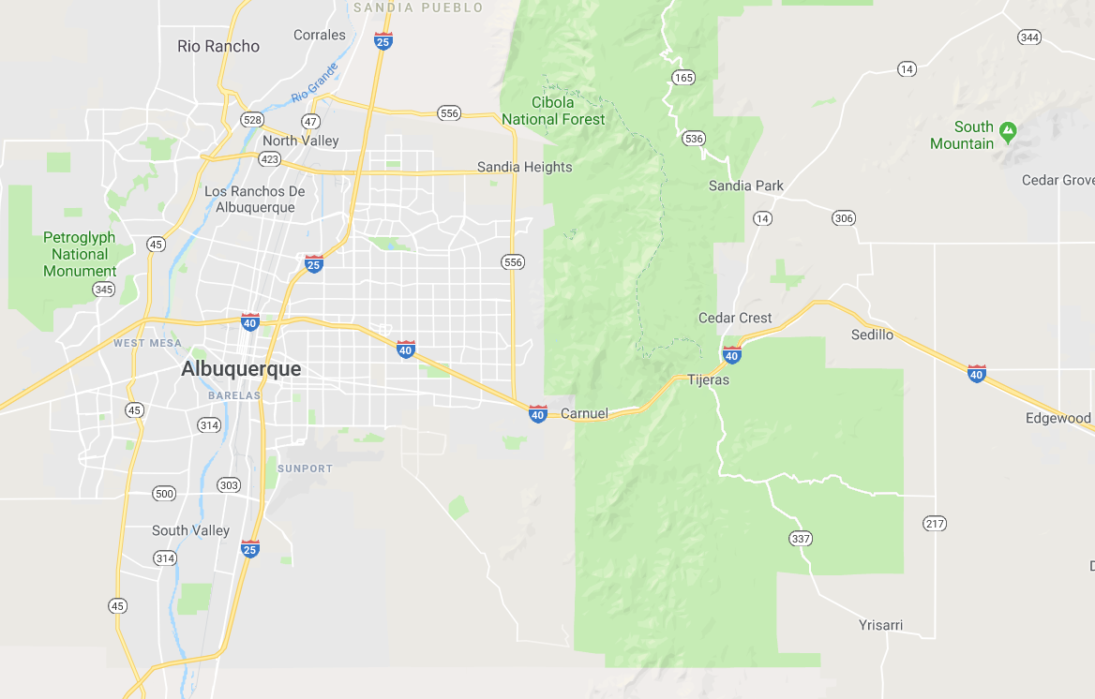
Oak Flat

Slide 24
White Ridge
Light pollution score: Dark Green. Light pollution south-east
Altitude: about 5600 feet
Access: Dirt road. 2 wheel drive OK unless it rains.
Amenities: None.
Time from Albuquerque: 1 hour (30 minutes from Bernalillo)
Directions: Take 550 west. Before San Ysidro, turn left onto Cabazon road. Drive 4.4 miles, parking lot is on the right.
Misc: Parking lot is gravel, slightly sloped fenced in area. Skies are best to the west. Beautiful views of Cabazon Peak
Why observe here: Reasonably dark, and fairly close to astronomers in the north valley, Rio Rancho and Bernalillo

Slide 25
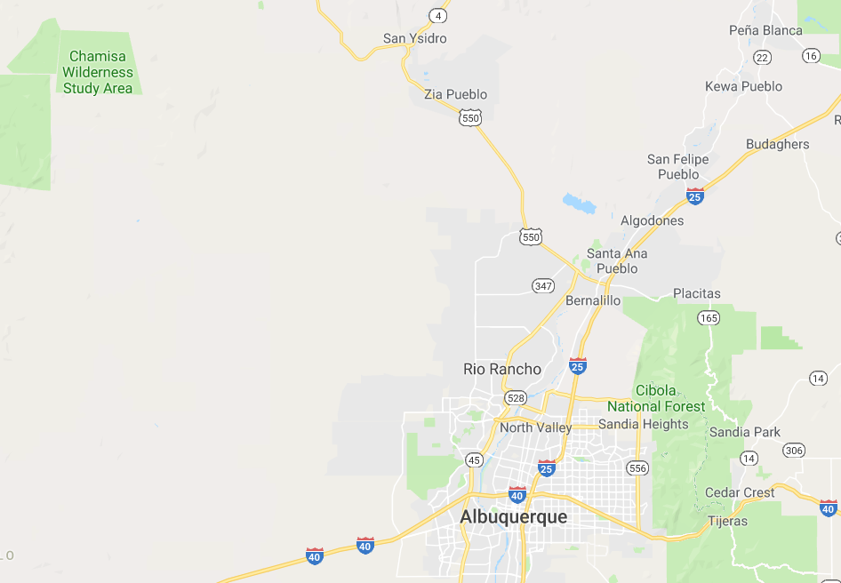
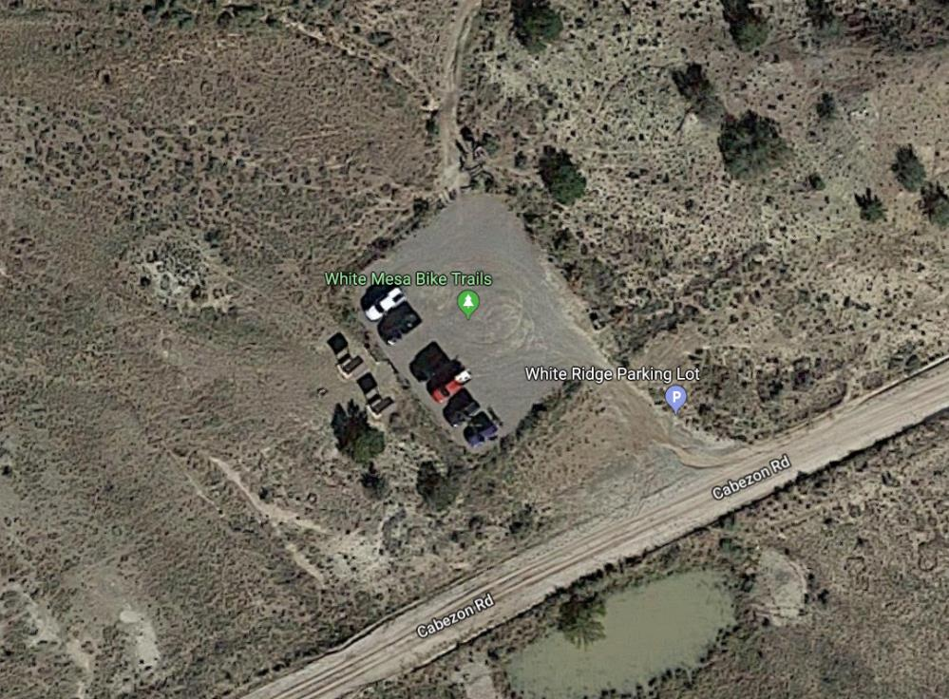
White Ridge

Slide 26
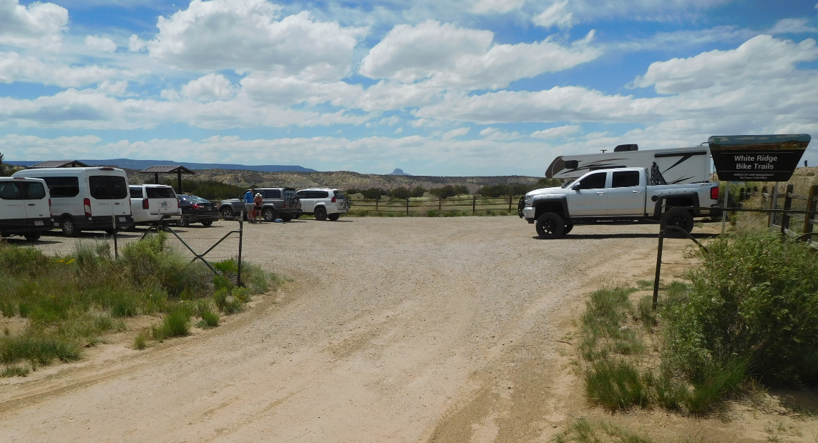
White Ridge

Slide 27
Datil Well
Light pollution score: DARK BLACK. No light domes
Altitude: about 7500 feet. May snow in winter
Access: Paved road. About 20 minutes west of the VLA.
Amenities: pit toilet, 10 or so campgrounds, tent camping. Near the town of Datil (with only one commercial building – restaurant, bar, gas, hardware store, grocery, restroom).
Time from Albuquerque: 2.5 hours.
Directions: Drive south to Socorro. Take the south Socorro exit, drive west about 1hour 15 minutes.
Misc: Bring a few 120 volt red light bulbs to temporarily use outside the toilets. Best observing sites are in the meadows.
Why observe here: Some of the best skies in North America.

Slide 28
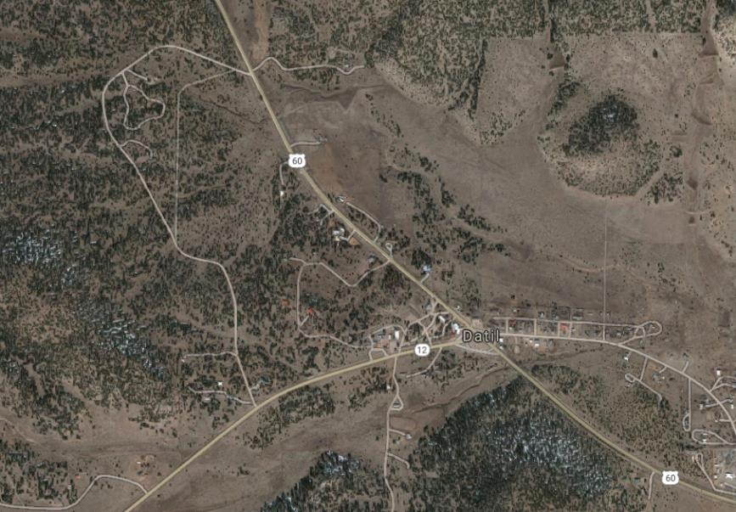
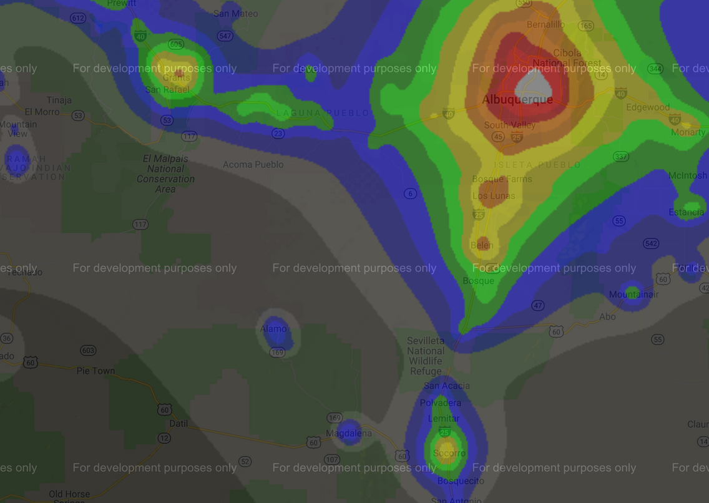
Datil Well

Slide 29
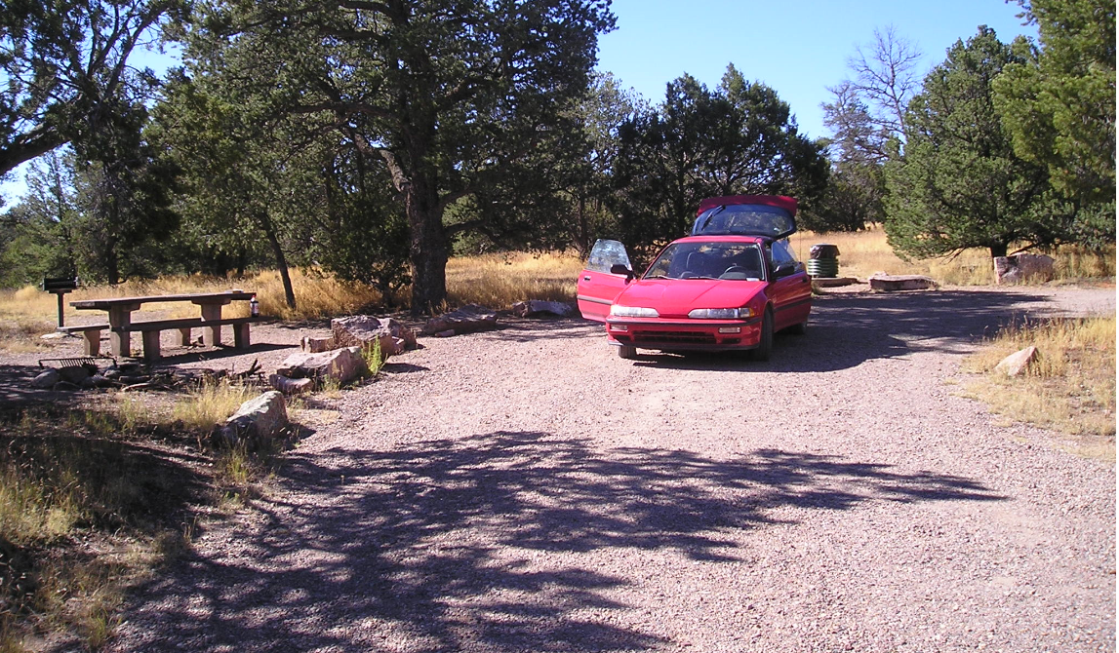
Datil Well

Slide 30
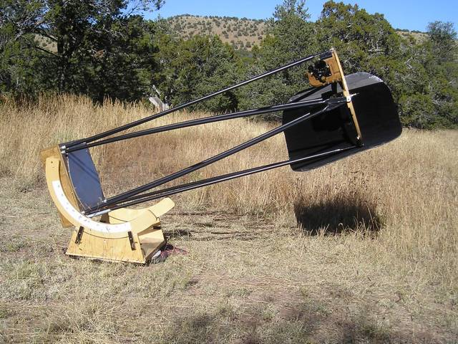
Datil Well

Slide 31
Valley of Fire
Light pollution score: GRAY. Minor light dome from Carrizozo.
Altitude: about 5400 feet. Same weather as GNTO.
Access: Paved road. About 5 minutes west of Carrizozo.
Amenities: pit toilets, 19 campgrounds. Near Carrizozo. Restaurant, motels, gas, grocery available
Time from Albuquerque: 2.5 hours
Directions: Drive south to San Antonio. Drive east to Carrizozo
Misc: The best observing site is at the end of the paved road, in the group campsite, in a low bowl. The local ranger will very likely invite everyone in the campground to an impromptu star party with you.
Why observe here: Dark skies and warm temperatures. Closeness of amenities.

Slide 32
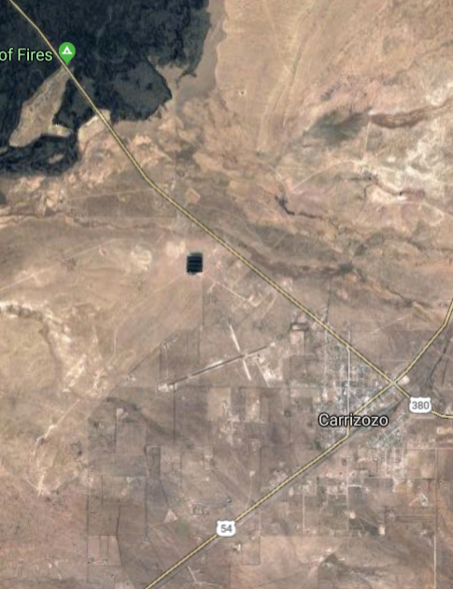
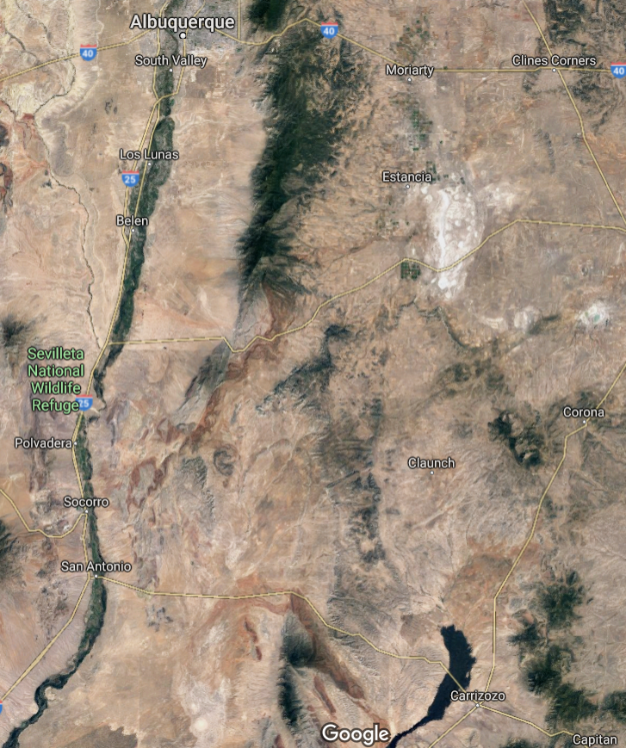
Valley of Fire

Slide 33
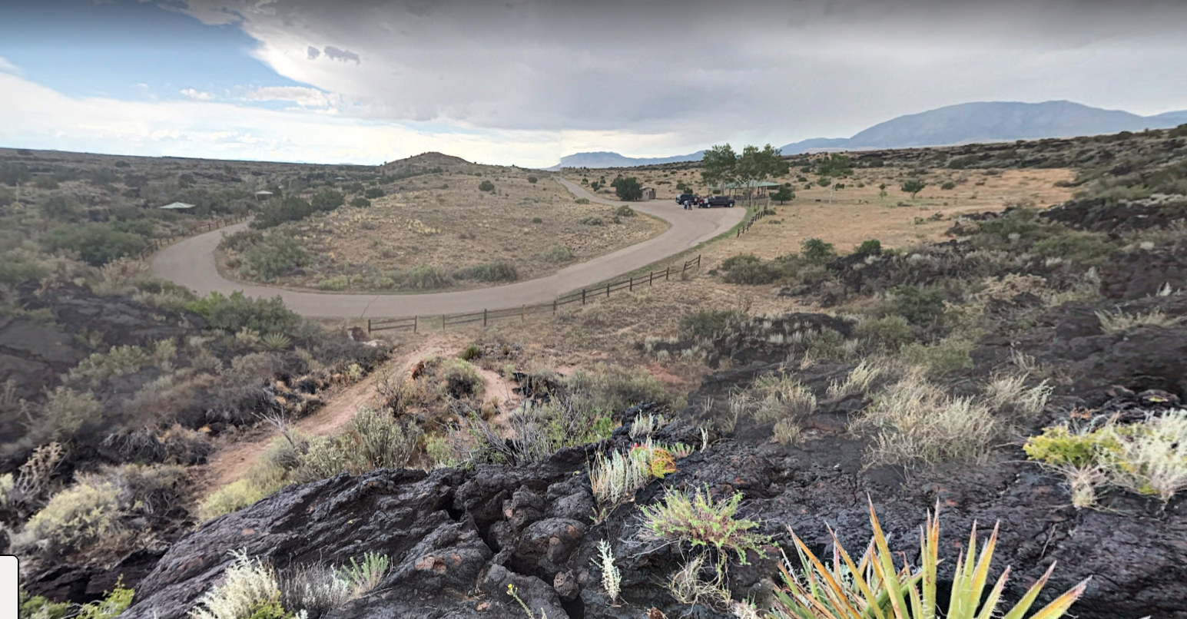
Valley of Fire

Slide 34
Priest Canyon
Light pollution score: BLUE. Minor Albuquerque light dome.
Altitude: about 6300 feet. 10-15 degrees cooler than the valley.
Access: Dirt road. Some parking spots require 4X4.
Amenities: None.
Time from Albuquerque: 1.5 hours (or less).
Directions: Drive south to Belen. Take road 47, then road 60 towards Mountainair. Take forest road 422 north about 5 miles.
Misc: Be very careful driving this road with a 2 wheel drive car. Observing area for 4 or 5 scopes. Soft dirt.
Why observe here: Relatively excellent skies, distance from Albuquerque.

Slide 35
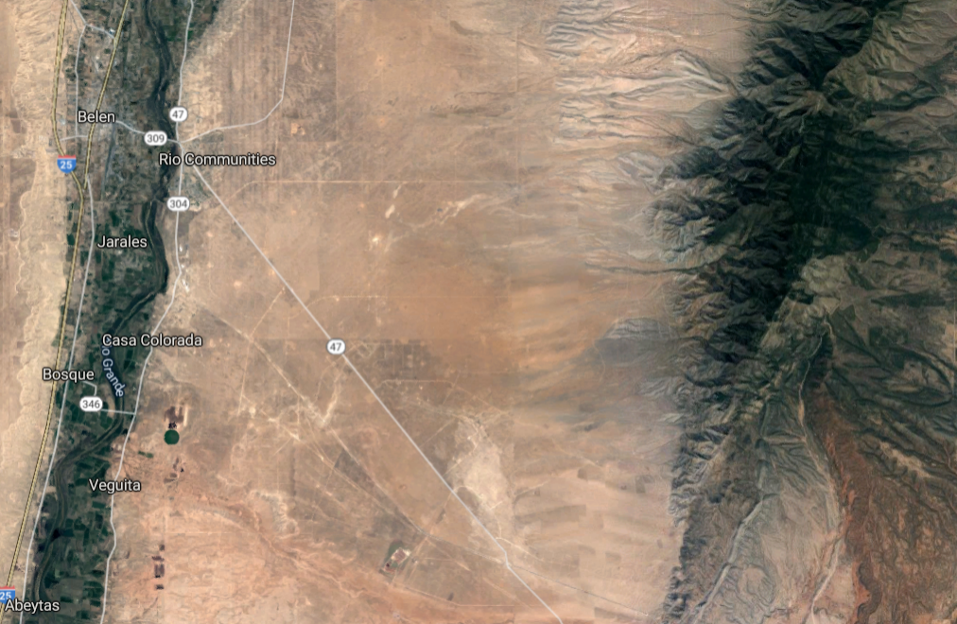
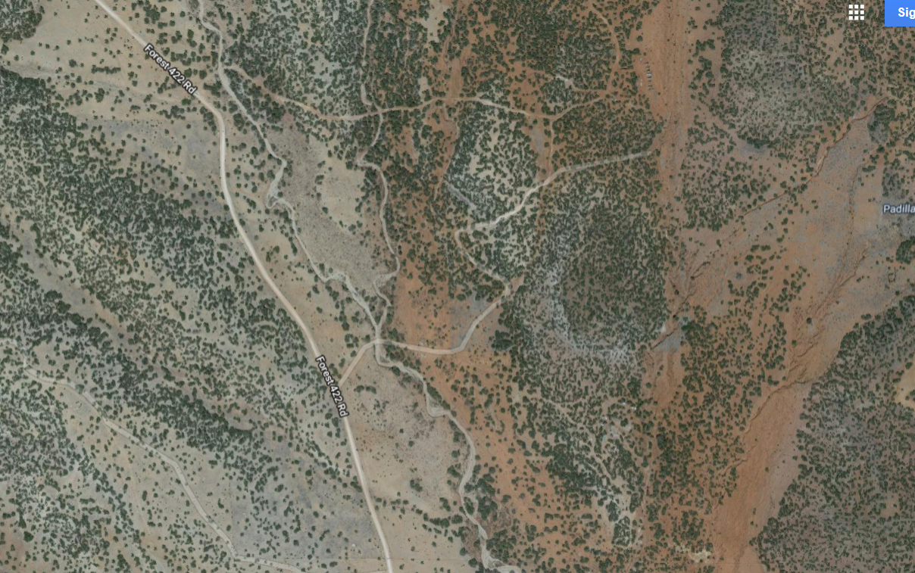
Priest Canyon

Slide 36
VLOA (Very Large Observing Area)
Private observatory in the east mountains
Location: TAAS members back yard in the east mountains.
Misc: Occasionally opened to TAAS members. I have never observed here.
Amenities: None.
Why observe here: Close to Albuquerque, reasonably good skies.
How to contact host: Send an e-mail to TAAS_TALK.

Slide 37
Okie Tex Star Party
Light pollution score: BLACK. Not a white light to be seen.
Altitude: about 4400 feet.
Access: Paved road to field. Field is dirt.
Amenities: See next page.
When held: September or early October.
Time from Albuquerque: 5 hours (or less).
Why observe here: Spectacularly dark skies. Transparency is generally excellent. Seeing is often good. Weather is generally very good.

Slide 38
Okie Tex Star Party
Tips and Tricks:
Where to stay: Closest hotels are in Clayton or Boise City. Tent camping is hot after the sun comes up. There are local B&B’s.
What to eat: Breakfast, lunch and dinner are available at the star party. Cosmic Café (hamburgers, etc.) is open from 10pm until 2am.
Stores: Closest gas, stores, ice etc. are in Clayton or Boise City.
Atmosphere: Okie Tex is a very informal star party. Port-a-poties are clean and abundant. So are garbage cans.
Strangest fact: Okie Tex runs for 8 days.
TAAS has a significant footprint at this star party.

Slide 39
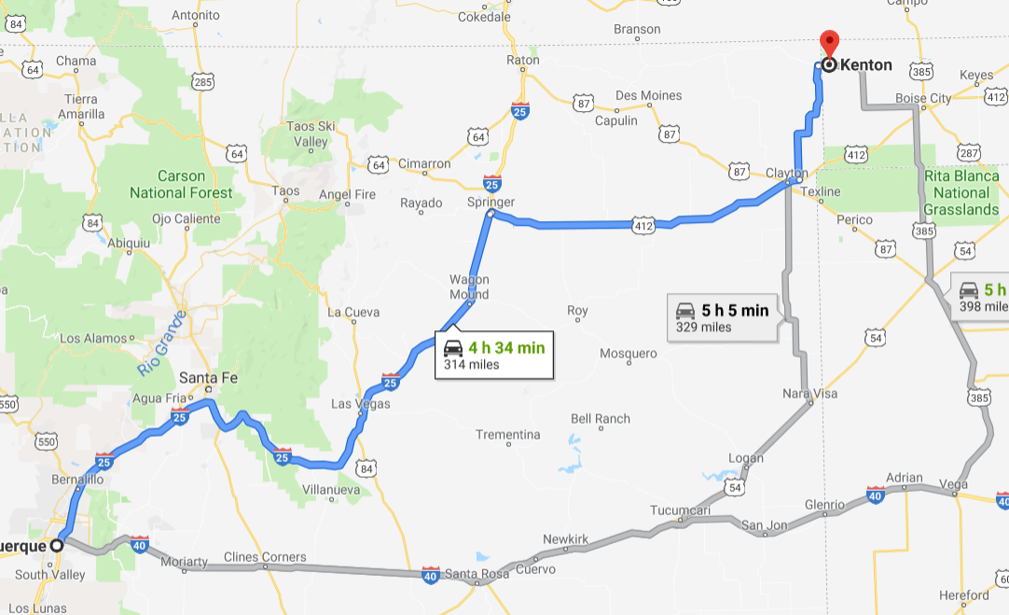
Okie Tex

Slide 40
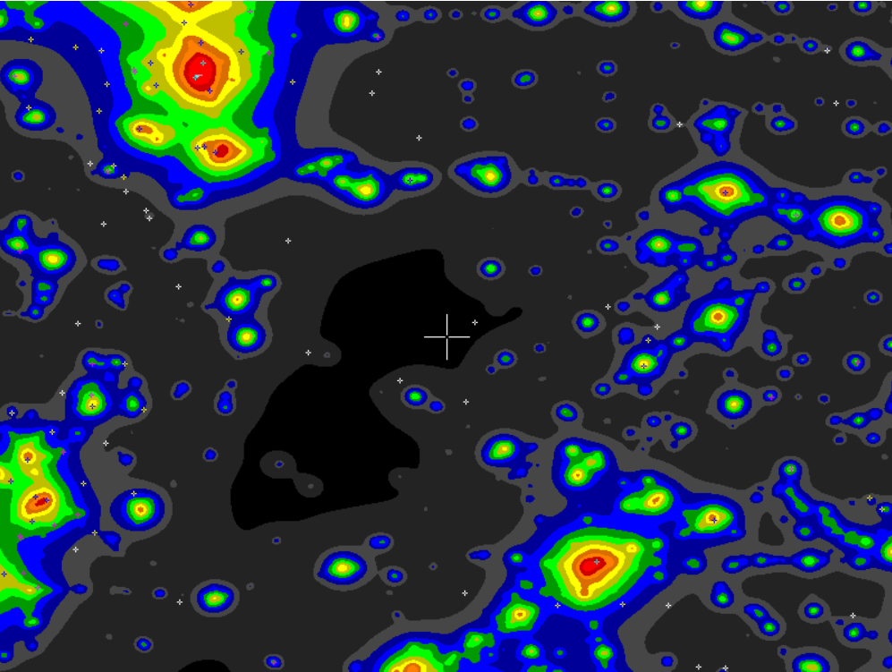
Okie Tex

Slide 41
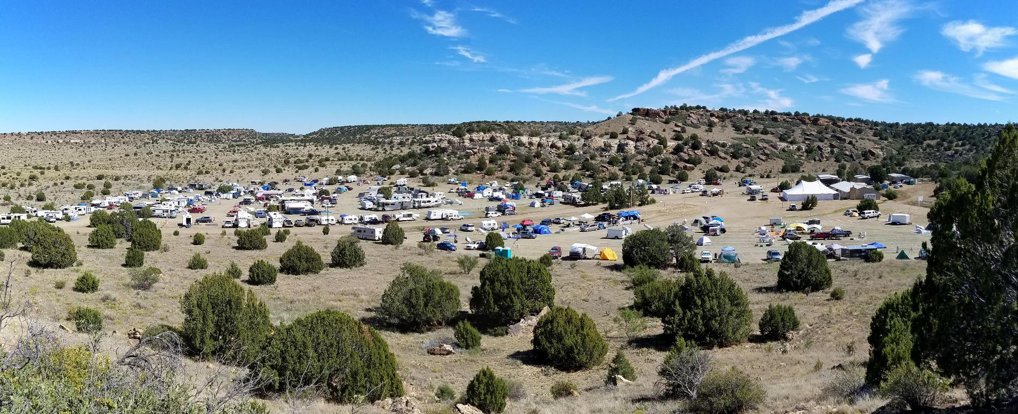
Okie Tex

Slide 42
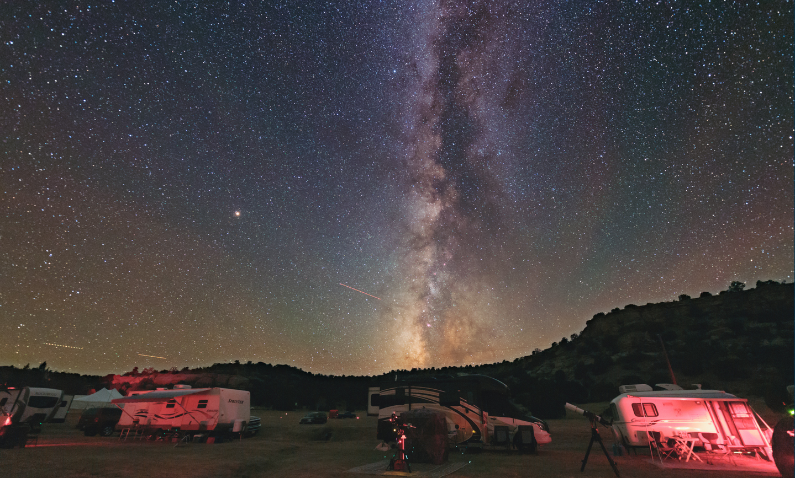
Okie Tex

Slide 43
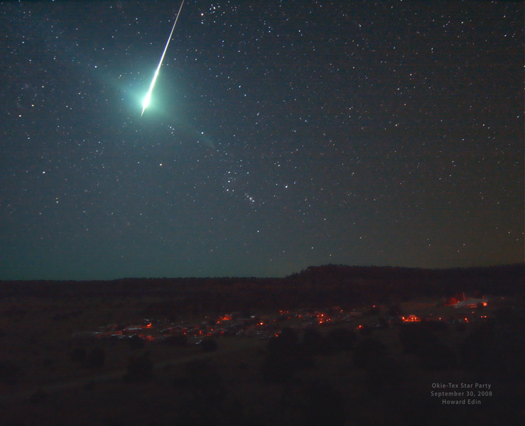
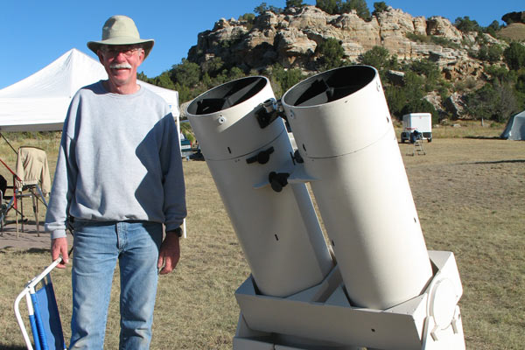
Okie Tex

Slide 44
Texas Star Party
Light pollution score: BLACK.
Altitude: about 5000 feet.
Access: Paved road to field. Field is dirt.
Amenities: See next page.
When held: Mid April through early June.
Time from Albuquerque: 7 hours.
Why observe here: Spectacularly dark skies. Transparency is generally excellent. Seeing is often good.

Slide 45
Texas Star Party
Tips and Tricks:
Where to stay: There are apartments and bunk houses onsite (allotted by lottery). Hotels are in Fort Davis. I stay at the Fort Davis Inn and RV.
What to eat: Meals at the Prude Ranch are very good. I get a meal plan for the week. A midnight Café (hamburgers, etc.) is open from 10pm until 2am.
Stores: Closest gas, stores, ice etc. is in Fort Davis, 5 miles away. Atmosphere: TSP is quite formal. Registration is checked at the entrance, and white/bright light police are onsite.
Things to do: Visit the McDonald Observatory. Drive to Big Bend.
Misc: The upper observing field has the best views south.
Strangest fact: Bathroom facilities are poor to disgusting.
TAAS has a significant footprint at this star party.

Slide 46
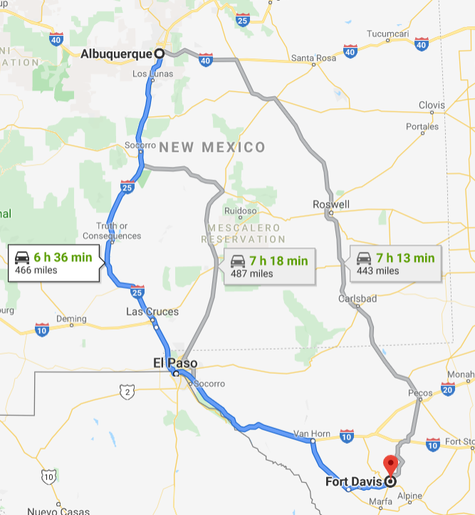
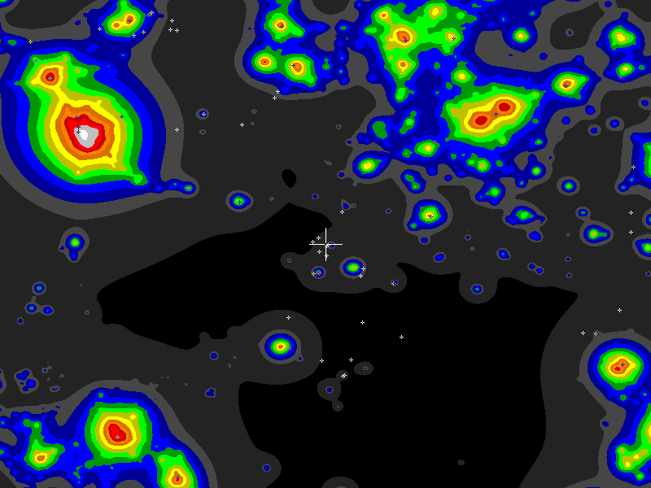
Texas Star Party

Slide 47
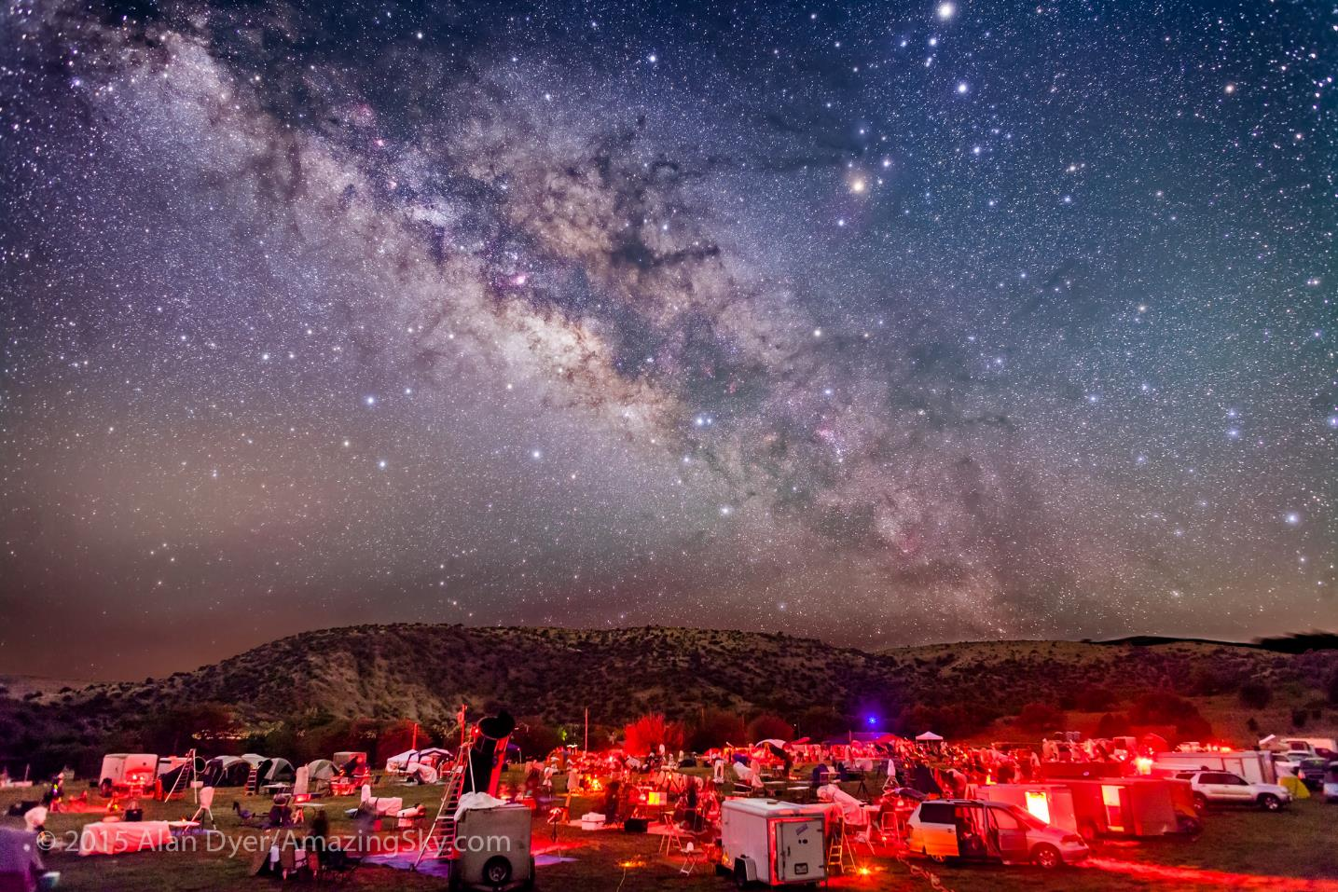
Texas Star Party
Credit: Alan Dyer/ AmazingSky.com

Slide 48
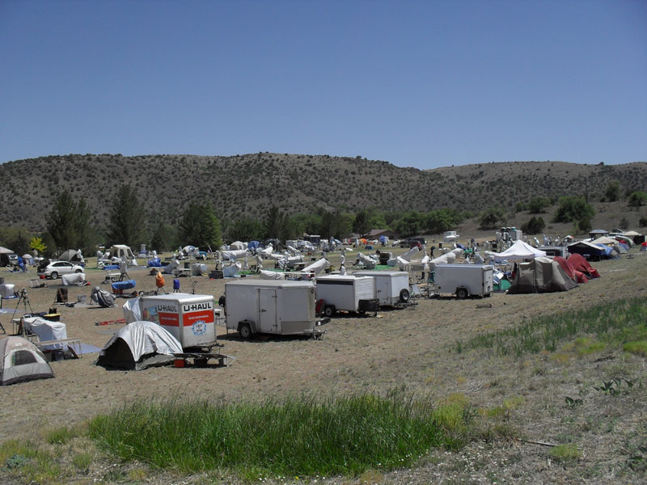
Texas Star Party

Slide 49
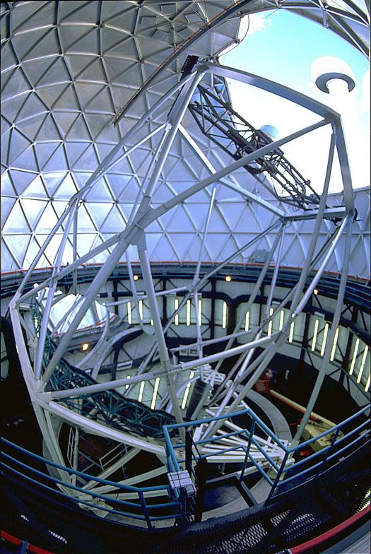
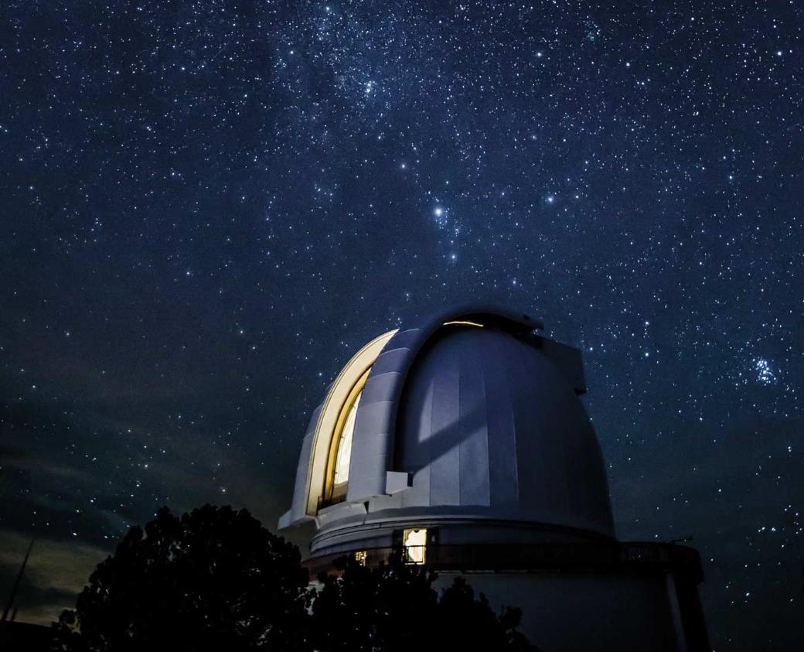
McDonald Observatory
Notes:
Harlan J Smith 2.7 Meter; Hobby-Eberly 10 Meter. Hobby-Eberly Spectograph only, fixed at 55 degrees. 5 times cheaper than conventional telescope. Mirror segments are spherical, and interchangeable

Slide 50
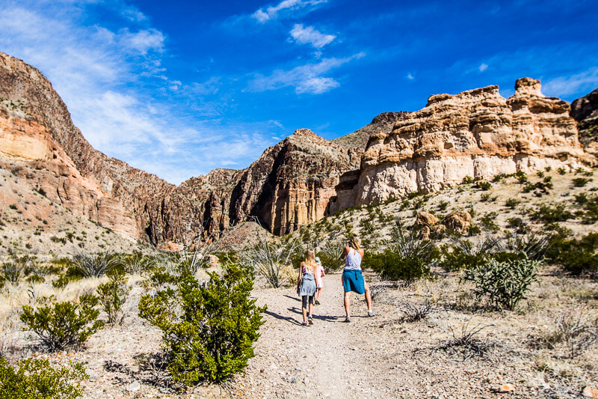
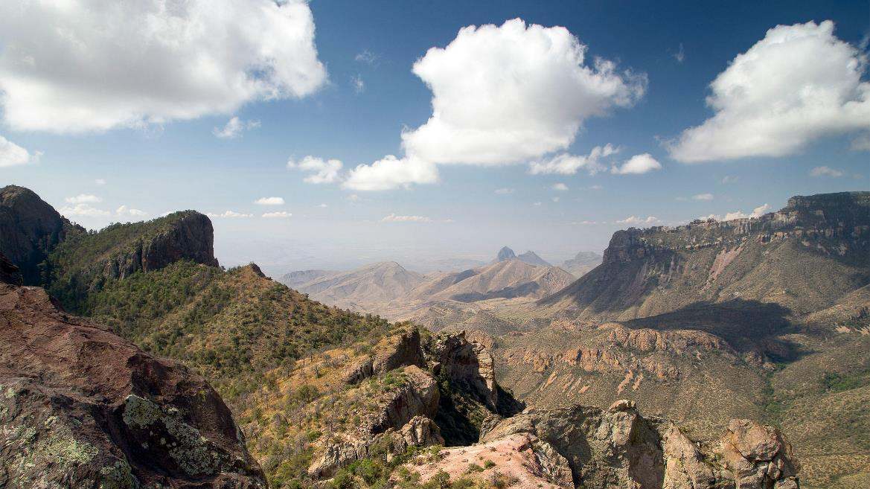
Big Bend National Park
Notes:
Harlan J Smith 2.7 Meter; Hobby-Eberly 10 Meter. Hobby-Eberly Spectograph only, fixed at 55 degrees. 5 times cheaper than conventional telescope. Mirror segments are spherical, and interchangeable

Slide 51
Enchanted Skies Star Party
Light pollution score: Light GRAY.
Altitude: about 6500 feet. 10 degrees cooler than the valley.
Access: Dirt road. Unknown
Amenities: Unknown.
When held: One month after Okie-Tex, i.e., October.
Time from Albuquerque: 1.5 hours.
Misc: Unknown. I have never observed here.
Strangest fact: Star party has evolved over time. Sounds like a very nice star party.
Why observe here: Reported as excellent skies, distance from Albuquerque.

Slide 52
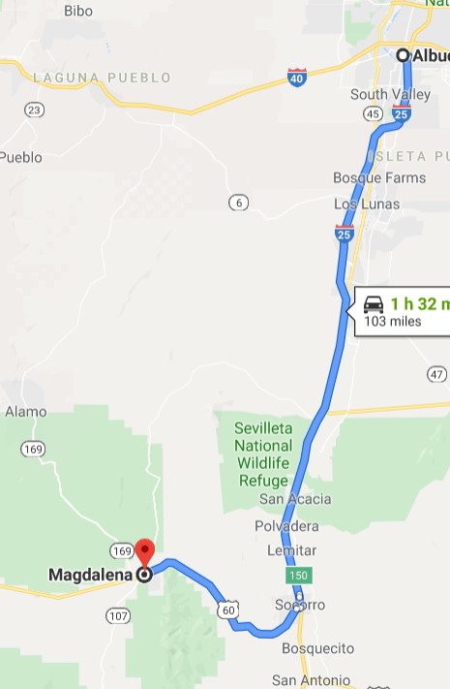
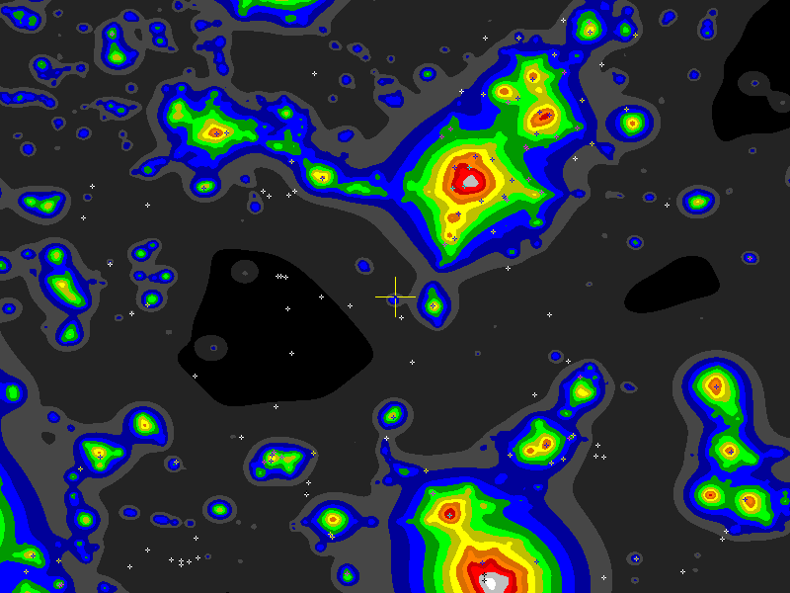
Enchanted Skies Star Party

Slide 53
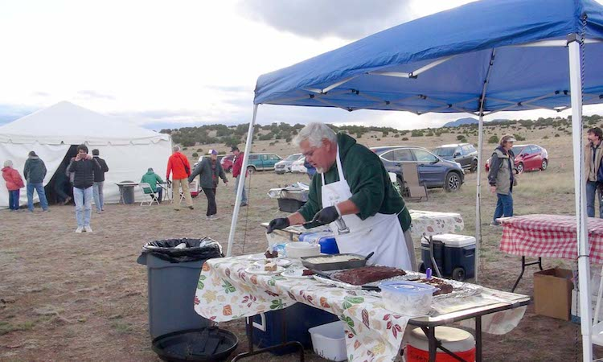
Enchanted Skies Star Party

Slide 54
Lets go observe!

